Slide 2
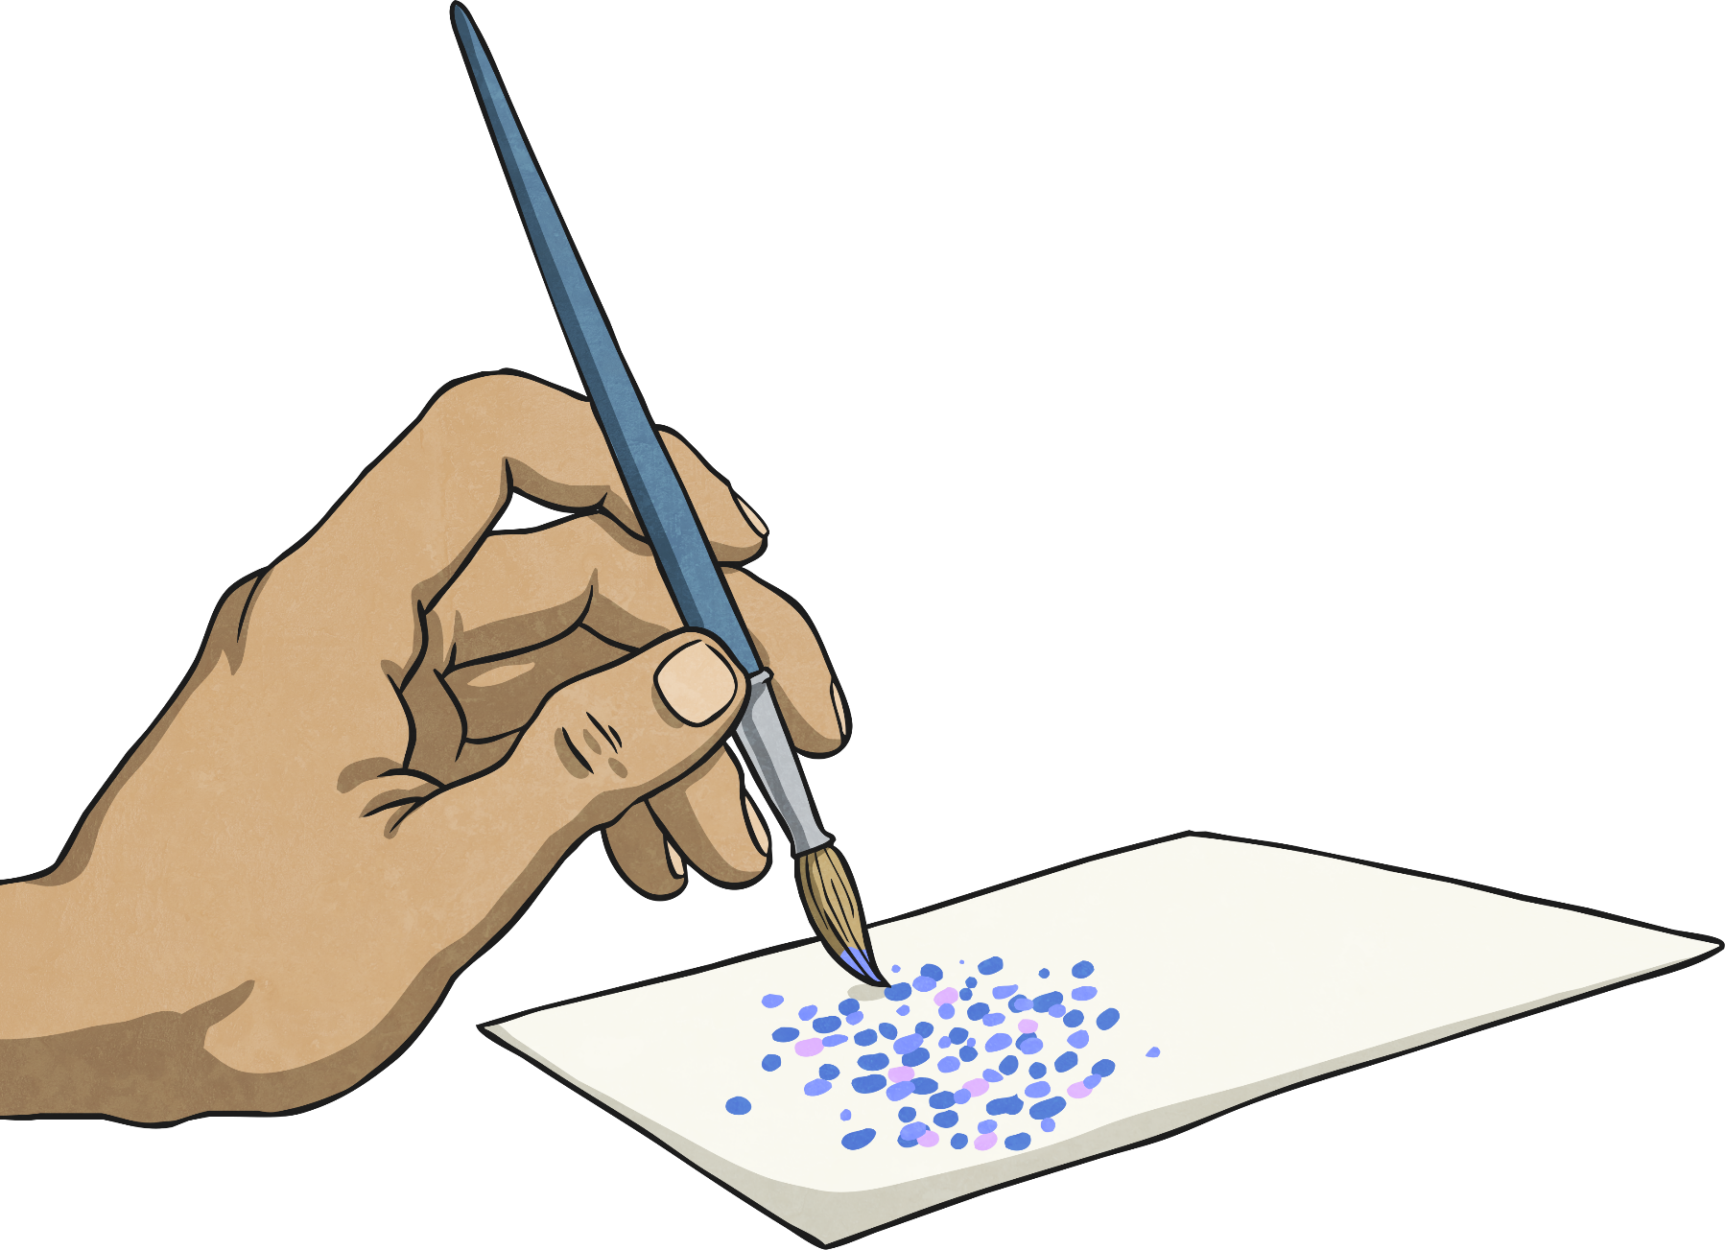
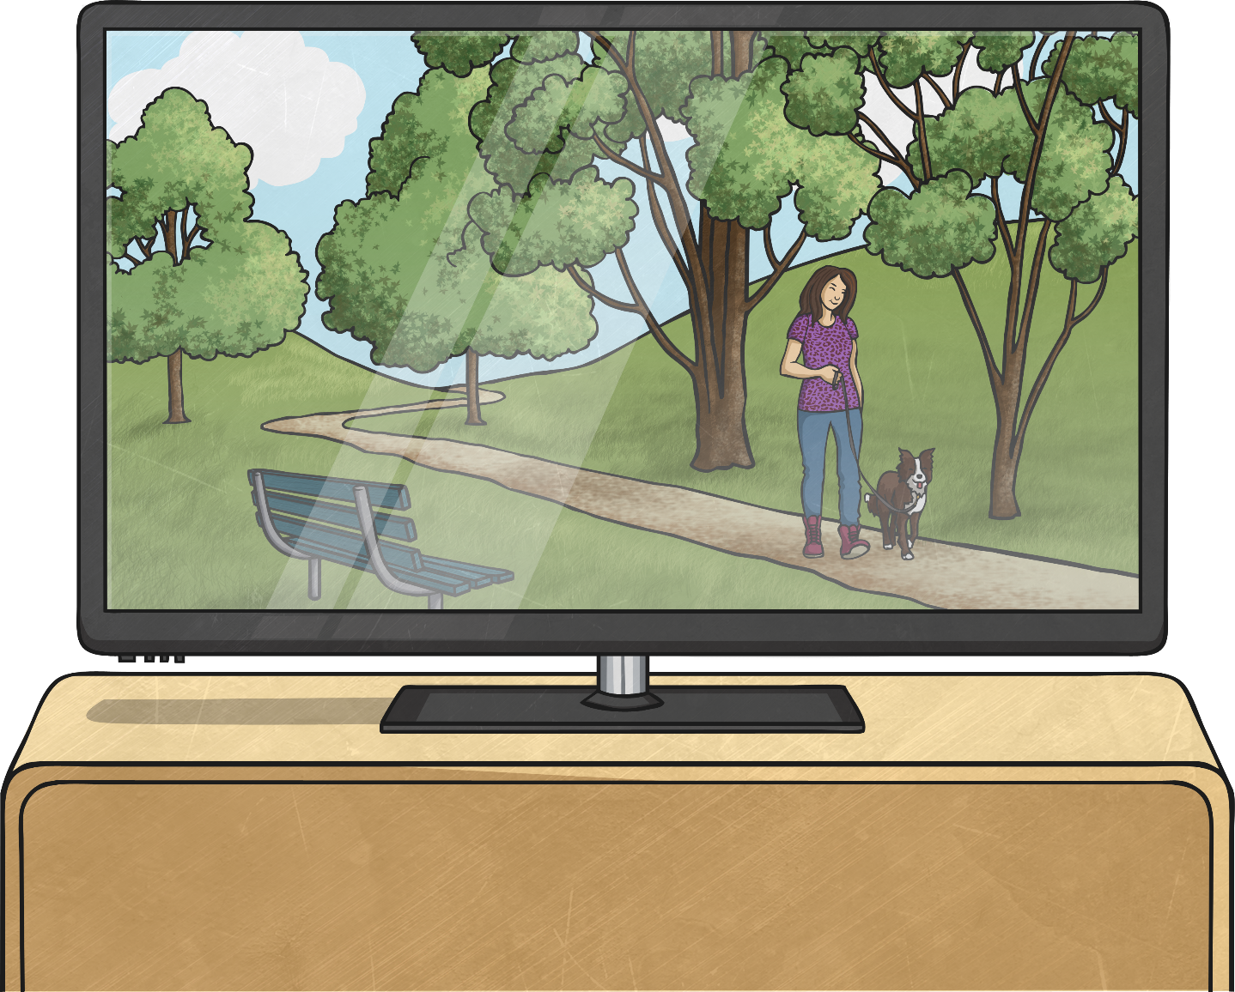
What is Pointillism?
Pointillism is a technique in painting where tiny dots of pure colour are applied to a canvas. The patterns that form with the tiny dots build up to create an image.

Slide 3
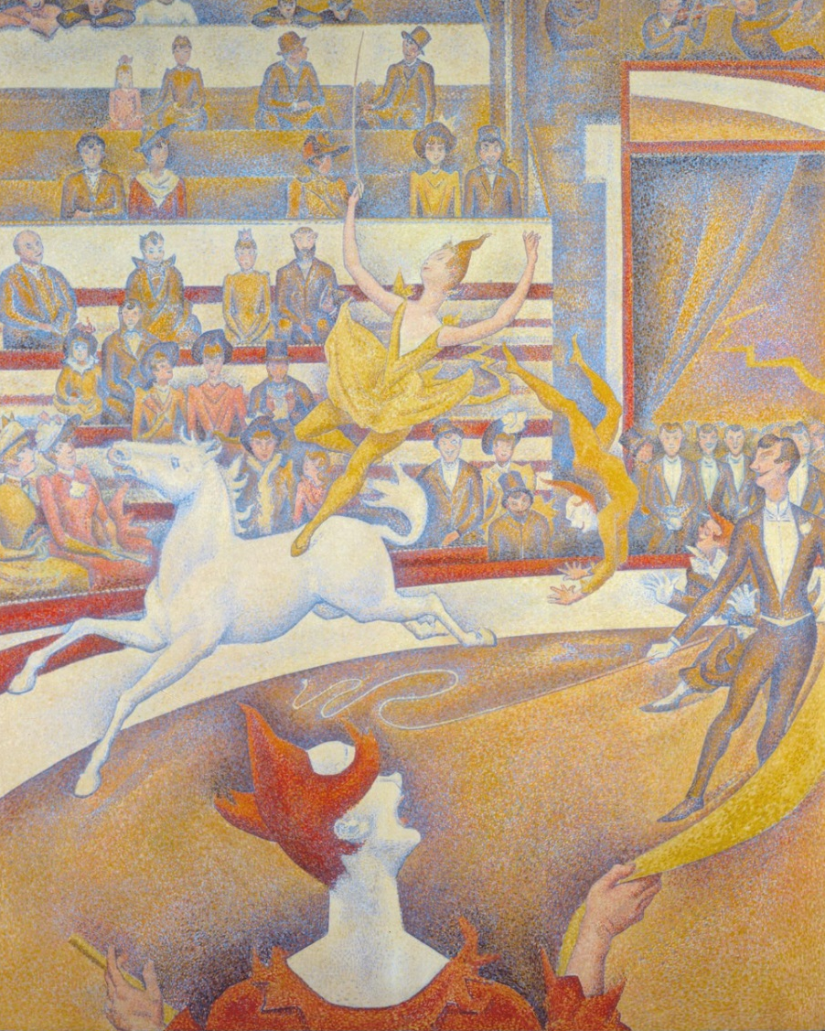
The Art of Science
Instead of the paint being blended and mixed on a palette, the paint is directly applied to the canvas. The fact that the dots are so close together cause the colours to appear blended.
Look carefully at the painting ‘The Circus’ by Georges Seurat. The dots are so close together, they seem to blur into different tones.
This is the science of optics.

Slide 4
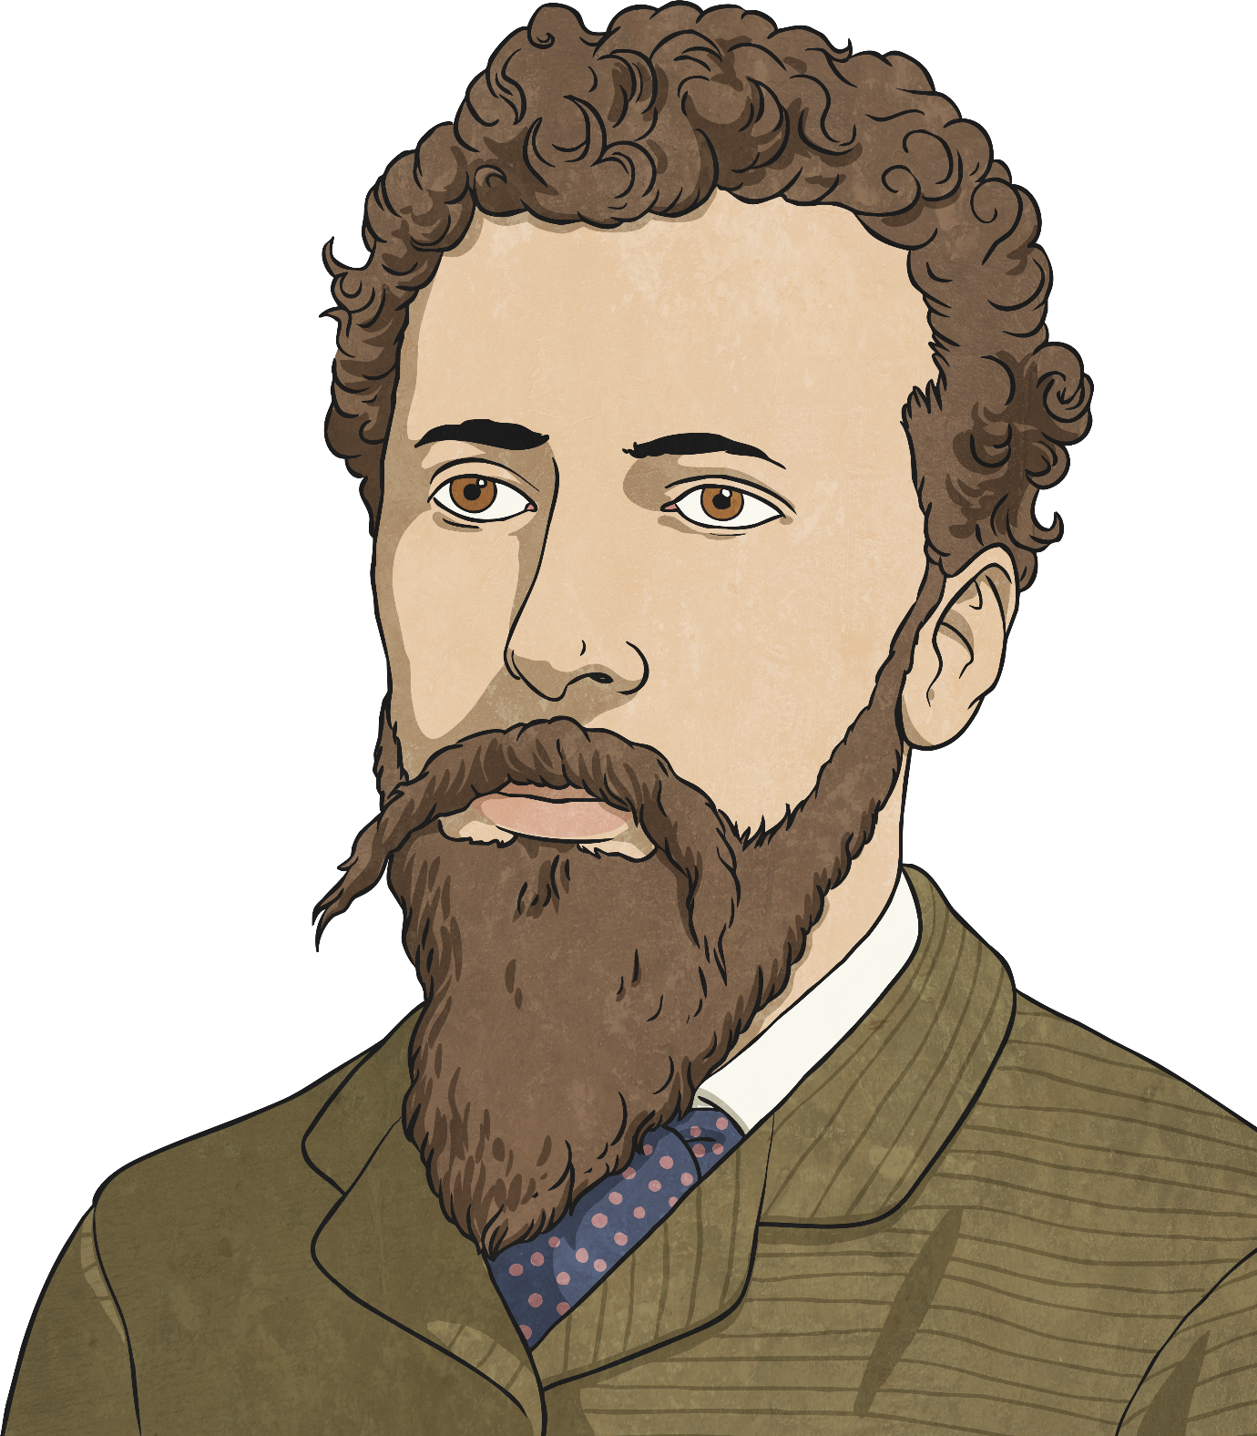
The Creation of Pointillism
The French artist Georges Seurat studied the application of colour and he created pointillism in the 1880s. He worked with other artists, and together they became known for this new artistic style.

Slide 5
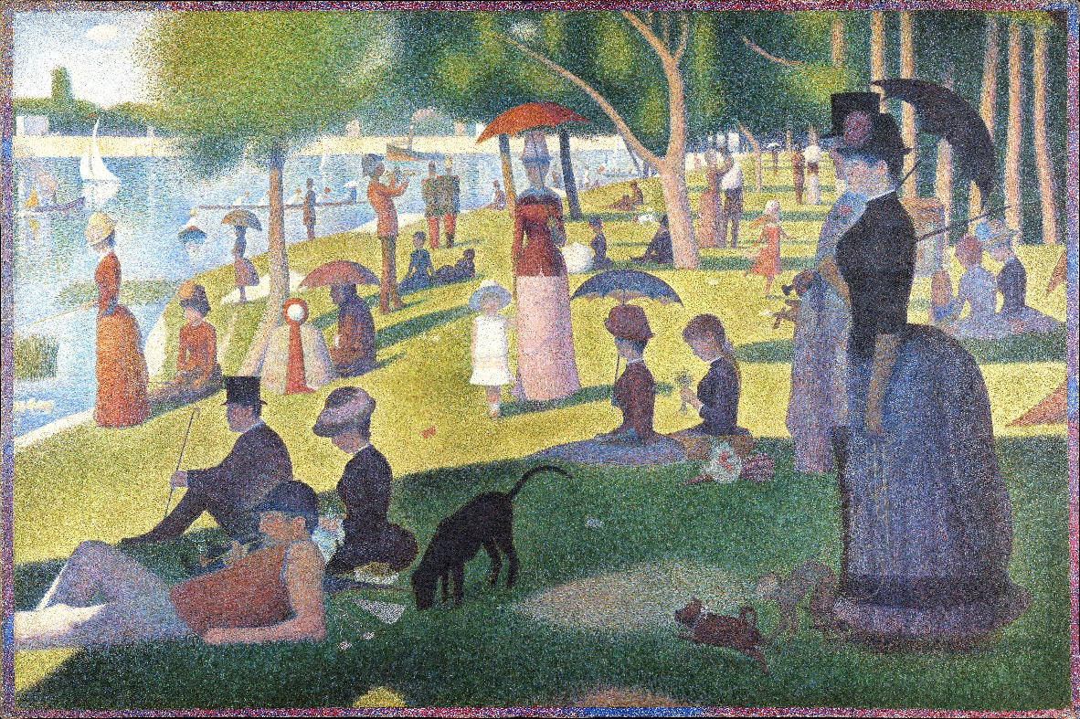
A Sunday Afternoon on the Island of La Grande Jatte Georges Seurat
Look carefully to see the tiny dots that make up the whole image.
Click the image for a closer look.

Slide 7
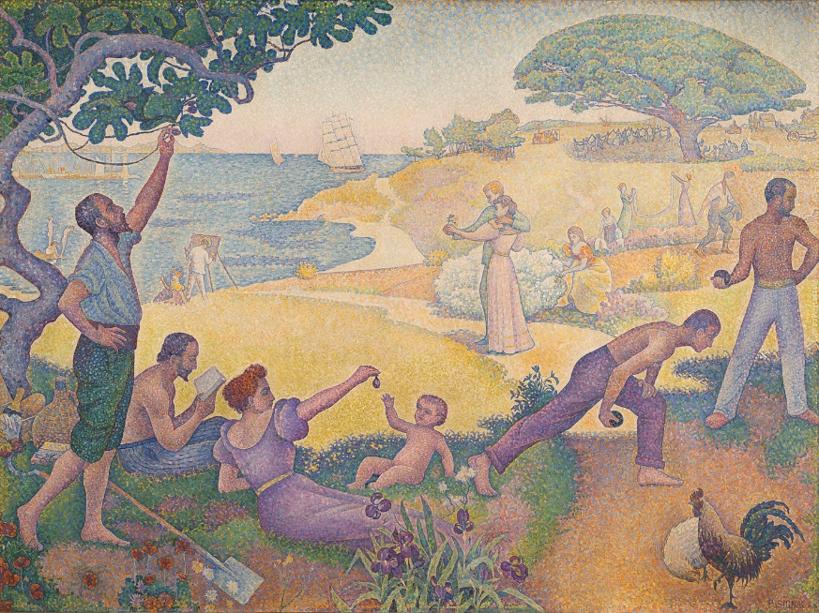
In the Time of Harmony; the Golden Age is Not in the Past it is in the Future Paul Signac
Signac loved the coast and often painted beach scenes.
Can you see any similarities with Seurat’s painting?
Click the image for a closer look.

Slide 8
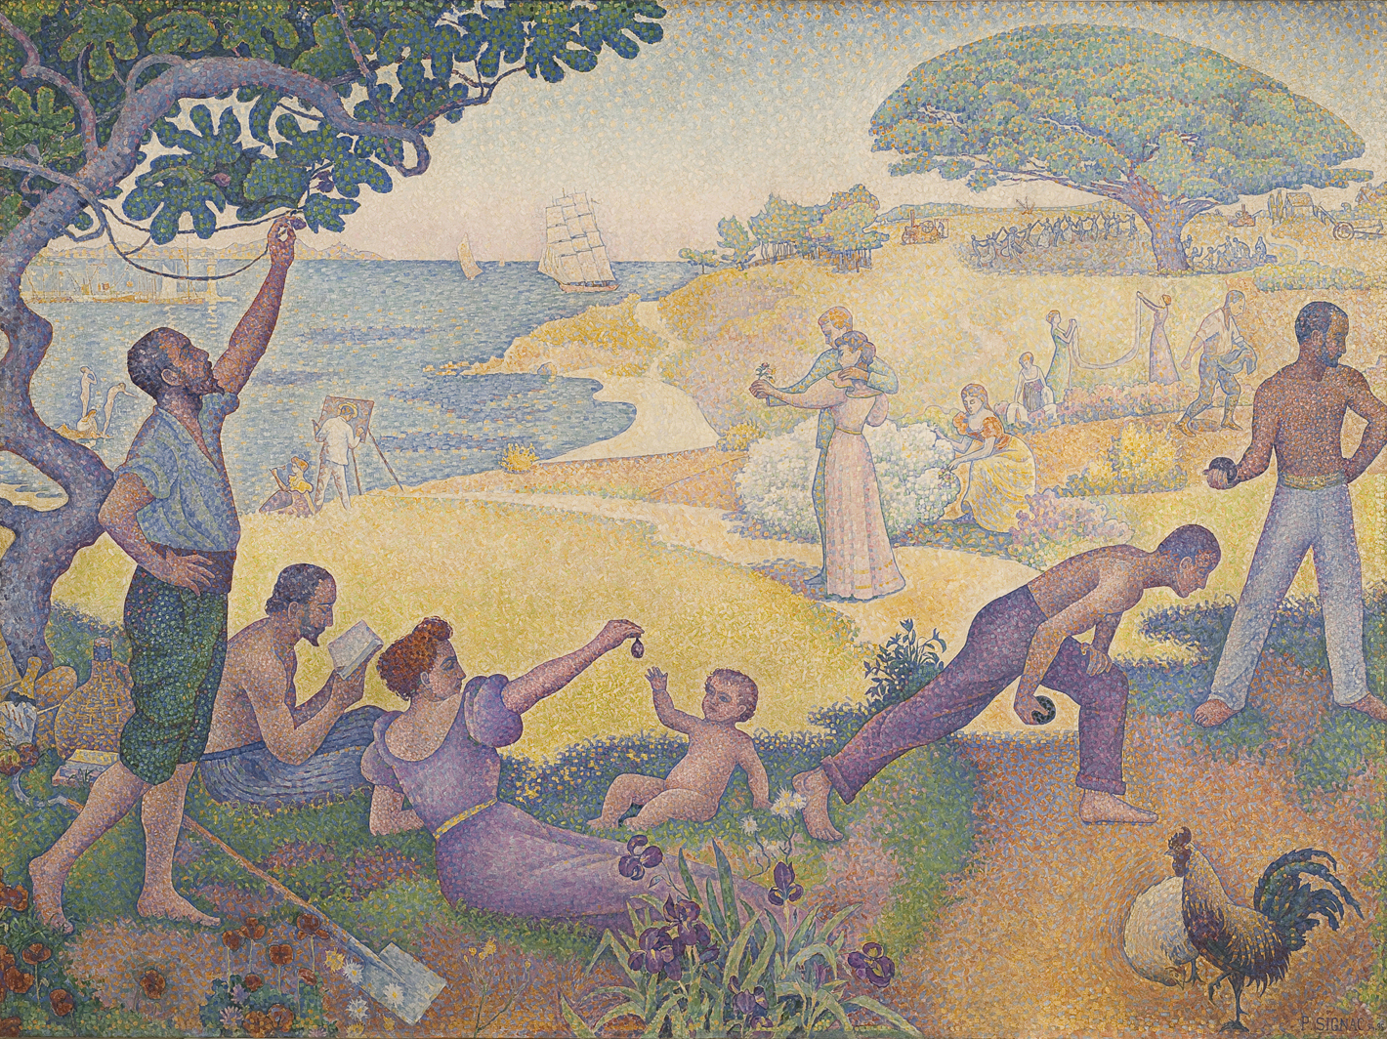

Slide 9
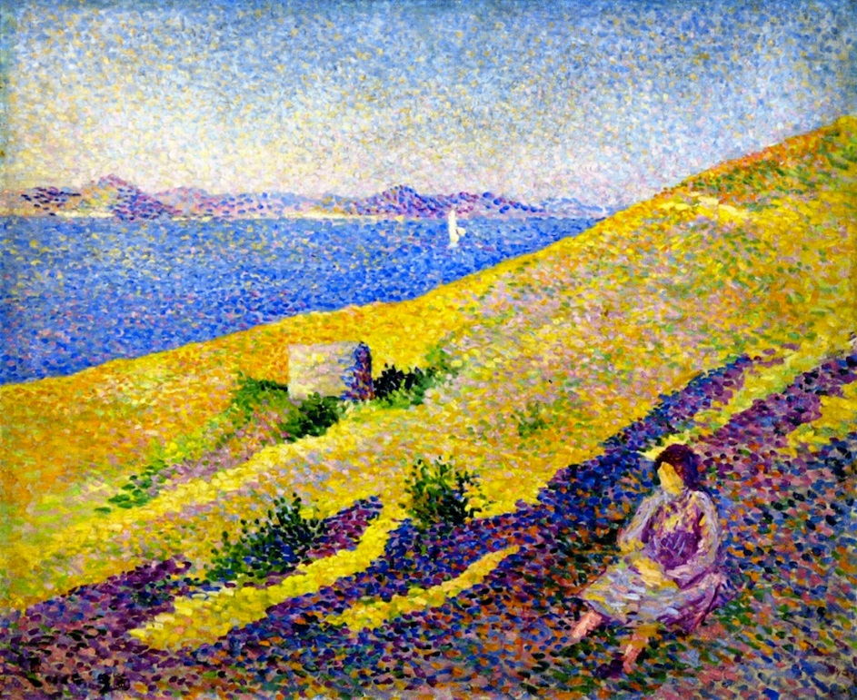
Côte de la Citadelle Maximillian Luce
Luce painted a wide range of different subjects, but mostly he painted landscapes.
Discuss how Luce creates a sense of perspective with a limited choice of colours.
Click the image for a closer look.

