Slide 1
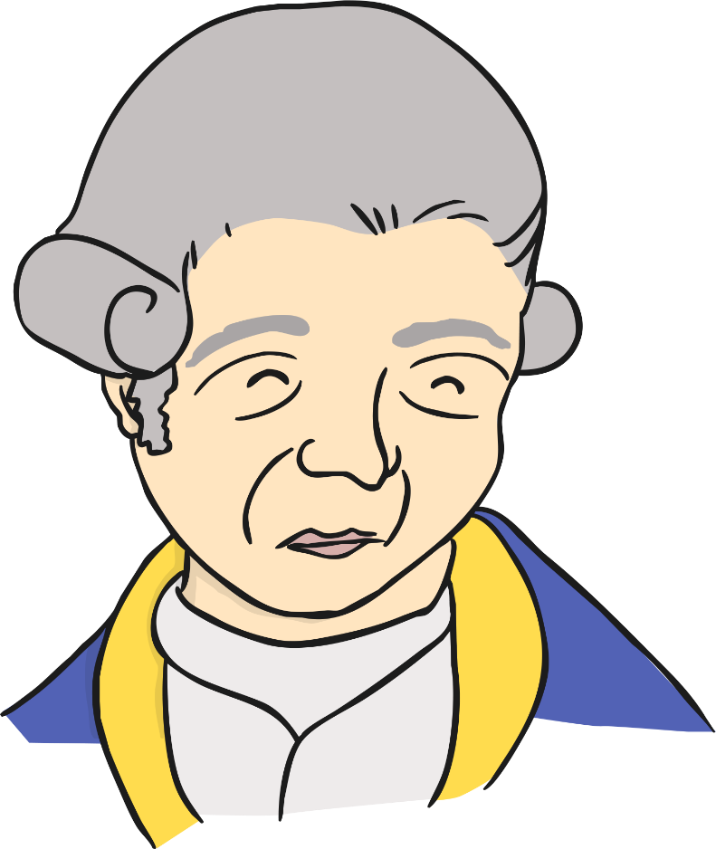
The Life of
Captain James Cook

Slide 2
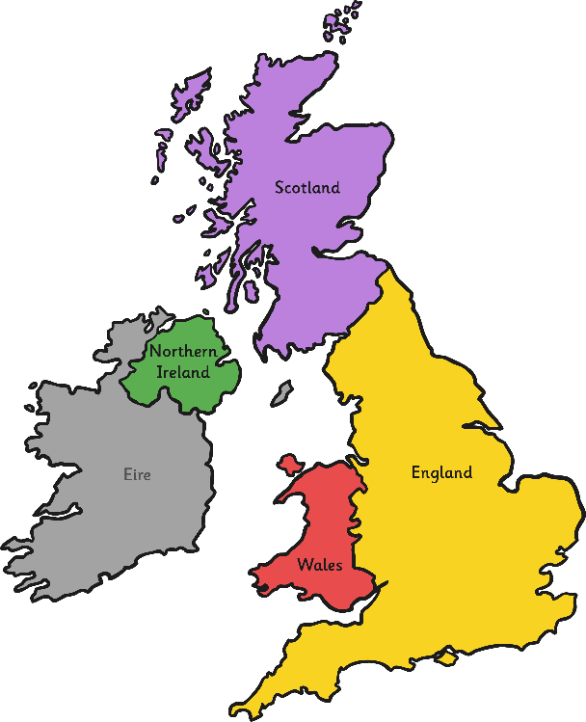
James Cook was born on November 7th, 1728 in Marton, Yorkshire, England.
His father was a farmer but as he grew older James became more and more interested in the sea. When he was about 18 years old he travelled to Whitby and got a job working on the coal ships.
Who Was James Cook?

Slide 3
He decided to join the Royal Navy in 1755 and learnt to sail ships. It was during this time that he became extremely good at making maps. His skills were noticed by people in charge in the Navy and in 1768 he was given the job of being in command of his first ship, called the Endeavour.

Slide 4
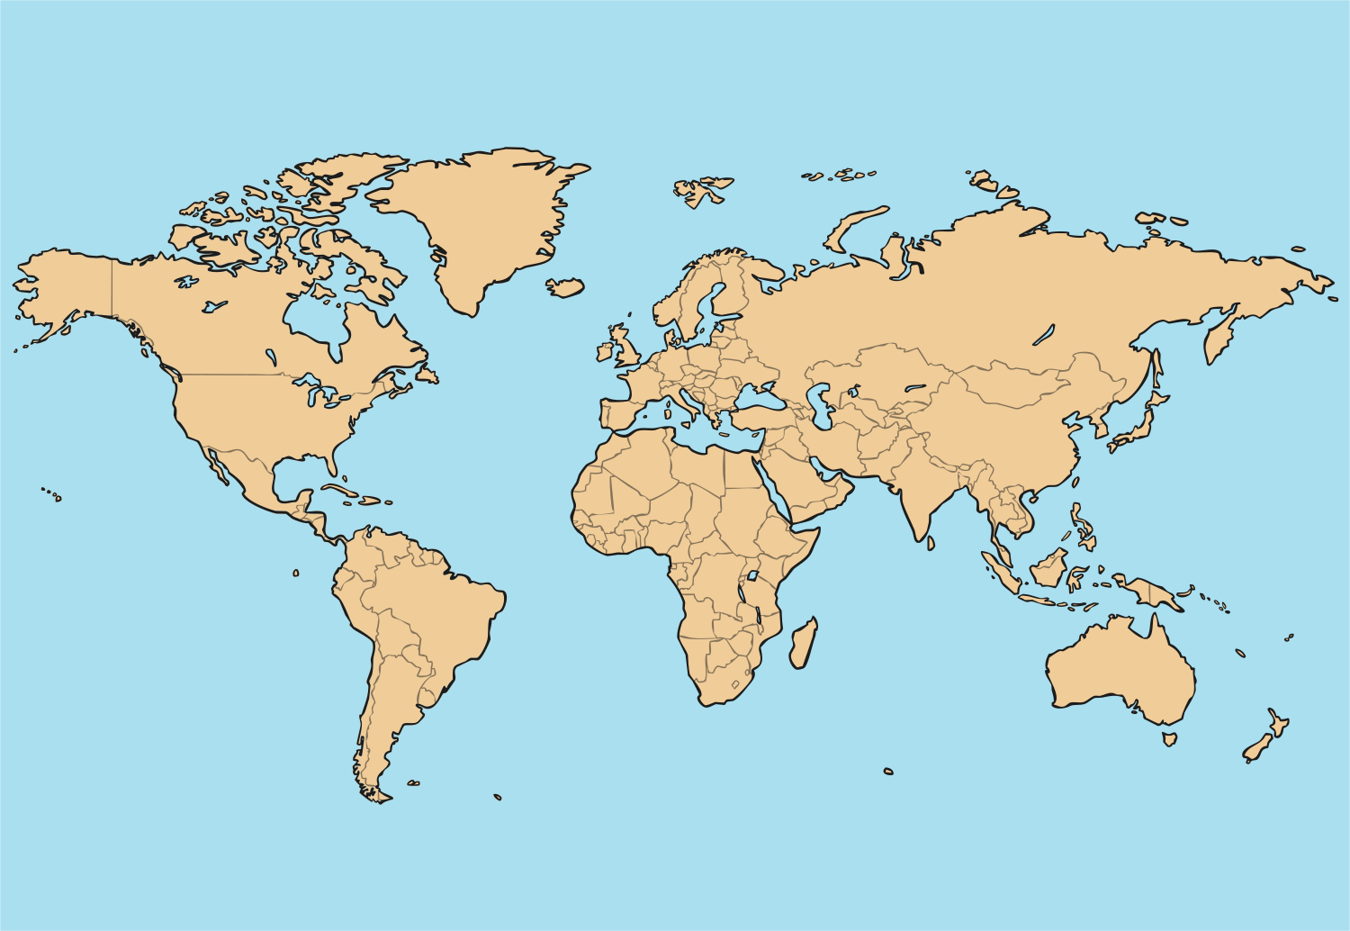
Cook’s first job was to sail to the Pacific Ocean and watch the planet Venus as it travelled between the Sun and the Earth.
Arctic
Ocean
North
Atlantic
Ocean
North Pacific
Ocean
Pacific
Ocean
Indian
Ocean
South Atlantic
Ocean

Slide 5
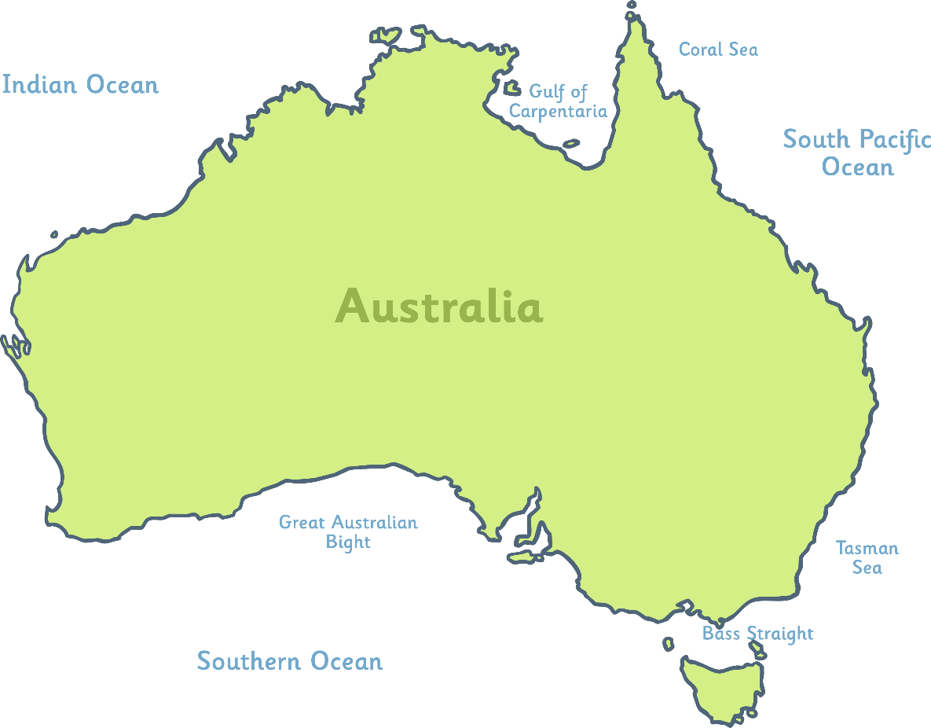
Cook and his crew sailed into the Pacific Ocean and on April 19th 1770 they found Australia. He claimed it for Britain, calling it New South Wales. They continued to sail east and on April 28th 1770 Cook anchored his ship and travelled onto the shore at Botany Bay.
Botany Bay

Slide 6
Next, they sailed north and almost got shipwrecked on the Great Barrier Reef. Cook and his crew stopped at North Queensland to repair the damage to their ship, at a place now called Cooktown, after James Cook.
Cooktown
Queensland
Great Barrier Reef
Botany Bay

Slide 7
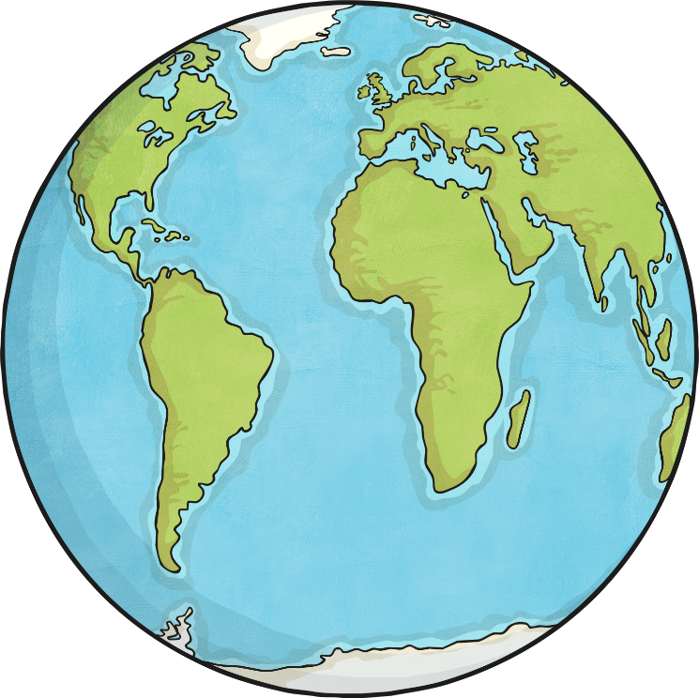
Cook and his crew then sailed back to England and arrived in July 1771. He shared his discoveries and became a very respected man.
Cook wanted to discover more places and in 1772 set sail again. His two ships came very close to the Antarctic but they had to turn back because of the cold.
Antarctic

Slide 8
They visited New Zealand and Tahiti before returning home to England in 1775.
James Cook’s third voyage was to be his last. He travelled with his crew south to New Zealand and then to the island of Hawaii. Whilst in Hawaii on 14th of February 1779, Cook got into an argument with a Hawaiian tribe when they stole one of his ships. There was a fight and Cook was killed.
Arctic
Ocean
Hawaii
North
Atlantic
Ocean
North Pacific
Ocean
Pacific
Ocean
Indian
Ocean
South Atlantic
Ocean
New Zealand and Tahiti

Slide 9
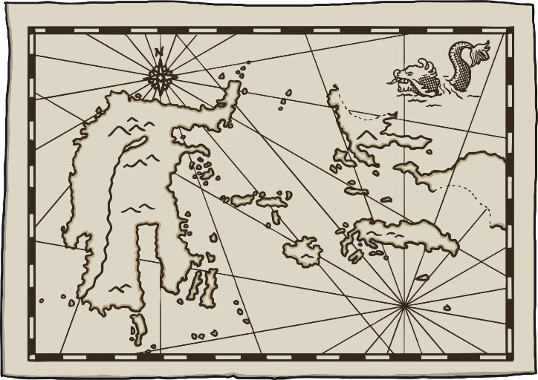
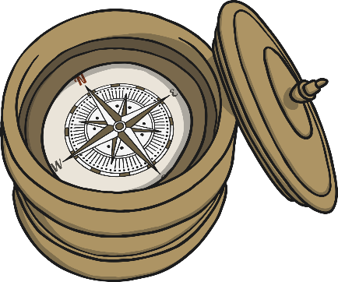
Some believe that James Cook’s discoveries helped to create many of the maps of the world.
He created the first accurate map of the Pacific Ocean.
Cook’s crew were very healthy compared to other sailors at the time. This was because Cook set rules for them to follow; they had to bathe daily and eat fresh fruit to fend off scurvy.
Facts About Captain James Cook

Slide 10
Design a poster that you think would have been advertised by James Cook to recruit sailors for his travels into the scary, unknown seas!

